Slide 1


DEPARTMENT OF COMPUTER SCIENCE AND ENGINEERING
20CS7503 & DESIGN PROJECT – III
END SEMESTER PRACTICAL EXAMINATION- NOV / DEC 2025
REVIEW PRESENTATION
Batch No.: 7
Date: 29/11/25
Session: FN

Slide 2
DATA DRIVEN DIGITAL WARDROBE FOR APPAREL MANAGEMENT
Guide Name:
Mr. M. A. PRASANNA, B.E, M.Tech
ASSISTANT PROFESSOR – CSE
KRCT
Team Members:
SHANMATHI S (811722104141)
UMA MAHESWARI K (811722104170)
VEDHA VARSHINI V (811722104178)

Slide 3
OBJECTIVE OF THE PROJECT
To create a digital repository of all clothing items owned by the user.
To track clothing usage frequency and identify overused and underused garments.
To generate smart outfit recommendations based on available clothes.
To support sustainability by reducing unnecessary purchases and maximizing wardrobe reuse.
To capture and store clothing images and metadata through a mobile interface for user convenience

Slide 4
INTRODUCTION
The Digital Wardrobe project brings traditional clothing management into a smart digital platform.
It helps users organize and store wardrobe items efficiently using images and metadata.
The system analyzes clothing usage patterns to highlight how frequently each item is worn.
It generates data-driven outfit suggestions to improve dressing efficiency and creativity.
The project promotes sustainable fashion practices by encouraging optimal use of existing clothes.

Slide 5
LITERATURE SURVEY
TITLE OF PAPER | AUTHOR(S) | PAPER GIST | TECHNOLOGY USED
Smart Wardrobe: Using IoT and Cloud for Outfit Recommendation | R. Kumar, S. Sharma | International Journal of Computer Science | IoT, Cloud Computing, Data Analytics
Data-Driven Approach to Sustainable Fashion Consumption | L. Niinimäki, G. Peters | Journal of Cleaner Production | Data Analytics, Sustainability Models
Intelligent Fashion Recommender System Based on User Preferences | Y. Lin, H. Chen | ACM Conference on Recommender Systems | Machine Learning, Recommender Systems
Digital Wardrobe: Personal Clothing Management Using Image Processing | P. Gupta, A. Verma | IEEE International Conference on Computing | Image Recognition, Database Management
AI in Fashion: Improving Apparel Retail with Predictive Analytics | K. Choudhury, M. Singh | Springer – AI & Society | Artificial Intelligence, Predictive Models

Slide 6
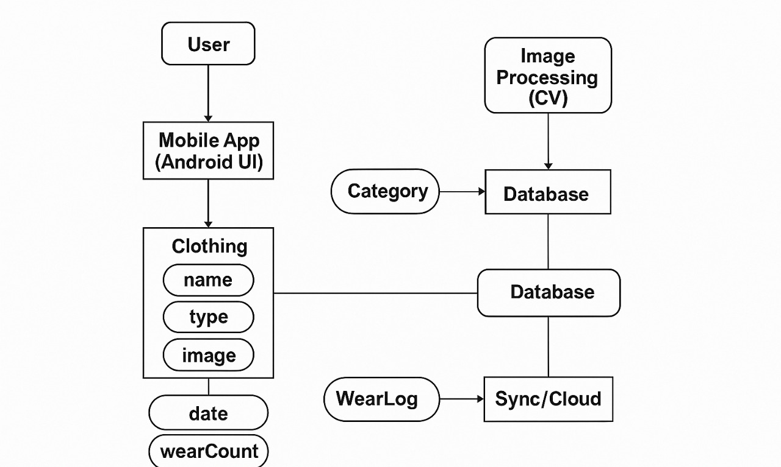
EXISTING SYSTEM ARCHITECTURE

Slide 7
PROBLEM IDENTIFICAITON
Users find it difficult to select outfits daily due to lack of organization.
There is no system to track usage frequency of clothes.
Many garments remain unused or forgotten, leading to waste.
Manual outfit planning is time-consuming and confusing.
Users cannot easily visualize matching color combinations or coordinated outfits.

Slide 8
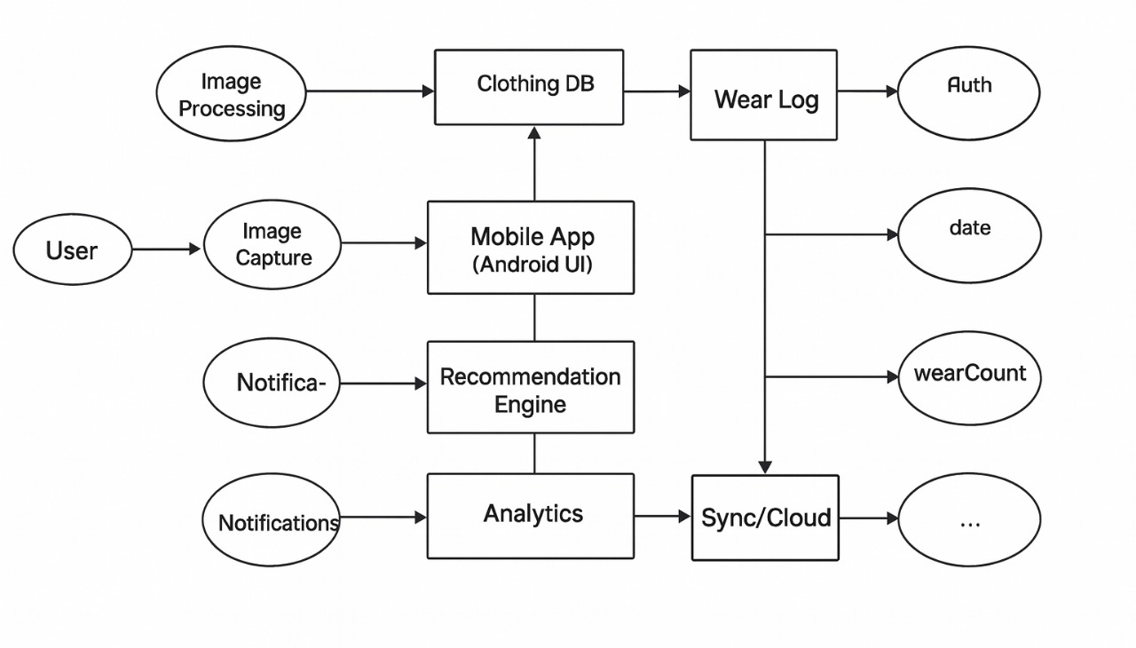
PROPOSED SYSTEM ARCHITECTURE

Slide 9
SOFTWARE AND HARDWARE REQUIREMENTS
HARDWARE
Laptop/PC with 8 GB RAM
Intel i3 or above Processor
256 GB HDD/SSD Storage
Smartphone Camera (8 MP or above)
SOFTWARE
Windows/Linux/macOS Operating System
Android Studio (Latest Stable Version)
Java Development Kit (JDK 8 or Above)
Android SDK Platform Tools

Slide 10
MODULES
1. Data Input & Collection Module.
2. Data Storage & Management Module.
3. Usage Analytics Module.
4. Outfit Recommendation Module.
5. Sustainability Insights Module

Slide 11
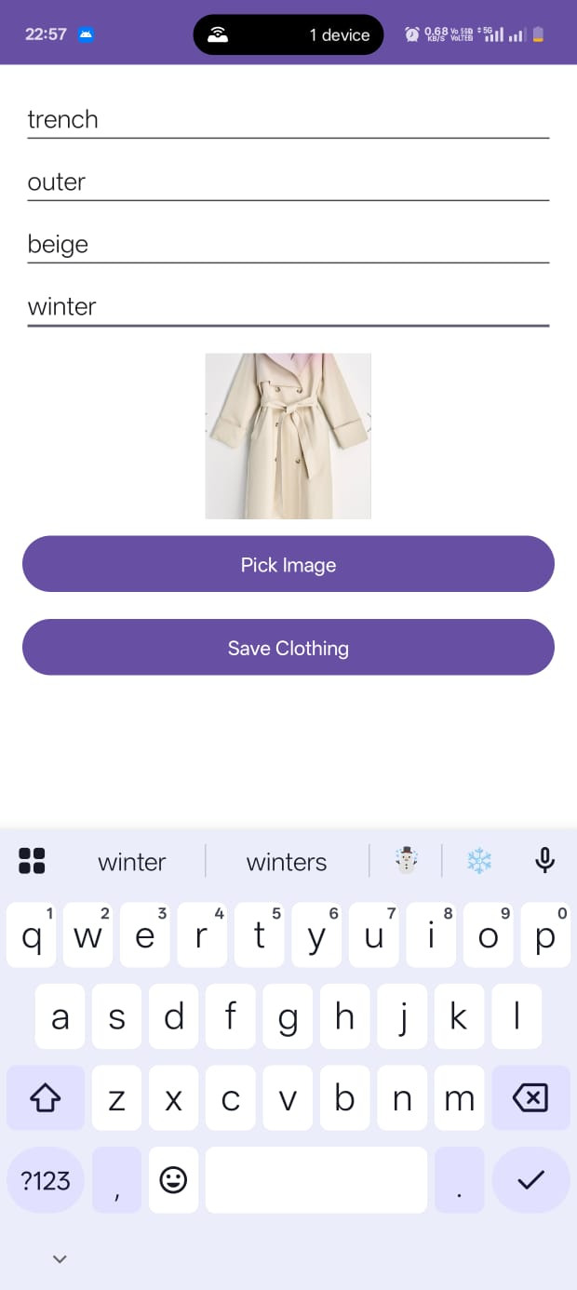
IMPLEMENTATION OF MODULE-1
Data Input And Collection Module:
Allows users to add clothing details like type, color, and size.
Accepts images of clothes for better identification.
Provides simple forms for manual entry of wardrobe items.
Prepares the system for future IoT or sensor-based inputs.

Slide 12
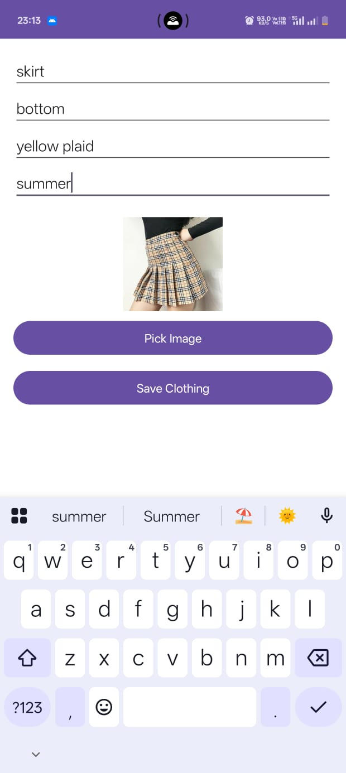
IMPLEMENTATION OF MODULE-2
Data Storage And Management Module:
Stores all clothing information in a structured database.
Maintains attributes such as purchase date, fabric, and usage frequency.
Ensures secure and organized storage of wardrobe data.
Provides easy retrieval of data for analytics and reporting.

Slide 13
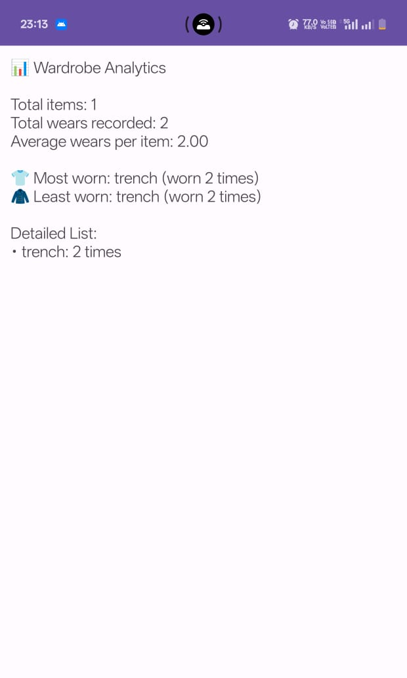
IMPLEMENTATION OF MODULE-3
Usage Analytics Module:
Tracks how often each clothing item is used over time.
Identifies unused or rarely used clothes in the wardrobe.
Detects frequently worn items that may require replacement.
Generates usage patterns for better decision-making.

Slide 14
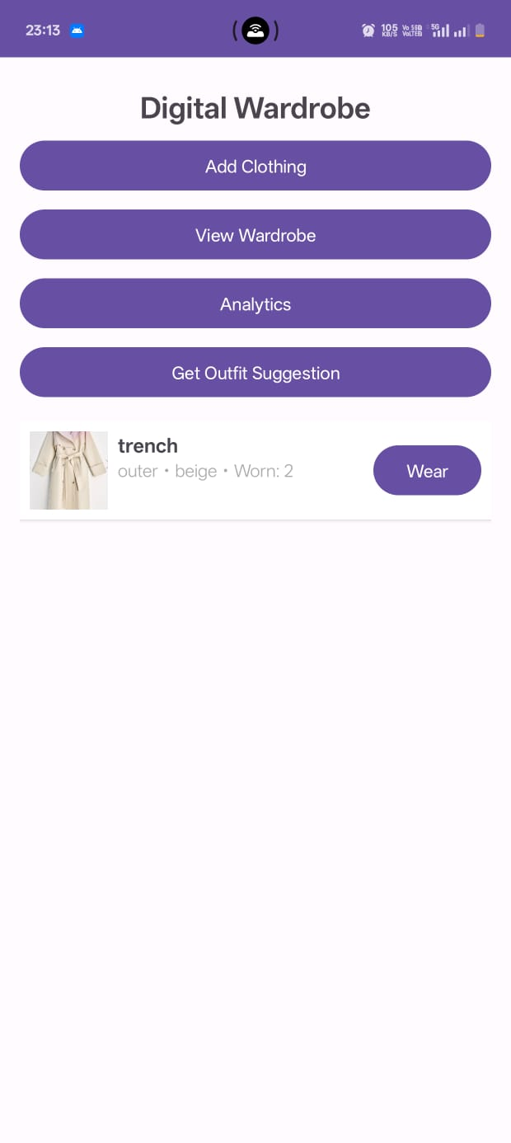
IMPLEMENTATION OF MODULE-4
Outfit Recommendation Module:
Suggests outfit combinations based on existing clothes.
Considers clothing type, color, and past usage for suggestions.
Helps maximize the use of underutilized wardrobe items.
Reduces the need for unnecessary shopping by reusing clothes smartly.

Slide 15
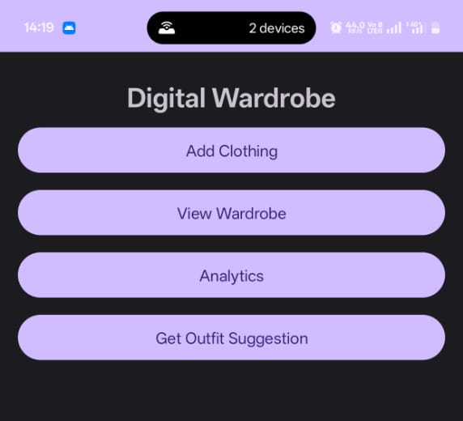
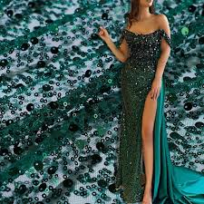
IMPLEMENTATION OF MODULE-5
Sustainability Insights Module:
Calculates the percentage of actively used vs. unused clothes.
Highlights wardrobe gaps to guide mindful shopping decisions.
Provides Eco-friendly fashion tips based on usage patterns.
Generates reports showing potential waste reduction and savings.

Slide 16
CONCLUSION
The project successfully digitizes wardrobe management, making clothing information easier to access and analyze.
It helps users track clothing usage and identify underused items in their wardrobe.
The system suggests outfit combinations that encourage smarter and more efficient clothing use.
By reducing unnecessary purchases, the project supports the idea of sustainability in fashion.
Overall, the project demonstrates how data analytics can improve personal wardrobe management while promoting eco-friendly habits.

Slide 17
FUTURE ENHANCEMENTS
Suggest clothing combinations using color and season matching with machine learning.
Store wardrobe data in Firebase so users can access it across devices.
Auto-detect clothing type and color from uploaded photos using image processing.
Log and visualize outfit usage trends over weeks or months.
Let users preview outfits on a virtual avatar or overlay using AR/VR.

